Slide 1
Engineering Management
Managing Engineering Design
Lecture 25,26,27

Slide 2
Objectives
• Describe the stages in systems engineering and the new product development process.
• Explain the importance of product liability issues in design.
• Describe the significance of reliability and other design factors.
• Describe the design factors of maintainability.
• Explain the importance of value engineering.

Slide 3
Nature of engineering Design
Design is the activity that best describes the engineer. To design is to create something that has never existed before, either as a solution to a new problem or as a better solution to a problem solved previously. J. B. Reswick summarizes the process of design well:
“Design is the central purpose of engineering. It begins with the recognition of a need and the conception of an idea to meet that need. It proceeds with the definition of the problem, continues with a program of directed research and development, and leads to the construction and evaluation of a prototype”

Slide 4
Systems engineering/New product development
Systems engineering is a robust approach to the design, creation, and operation of systems.
Systems engineering as defined by the International Council on Systems Engineering (INCOSE) is an engineering discipline whose responsibility is creating and executing an interdisciplinary process to ensure that the customer and stakeholder’s needs are satisfied in a high quality, trustworthy, cost efficient, and schedule compliant
manner throughout a system’s entire life cycle.
This process is usually comprised of the following seven tasks:
• State the problem
• Investigate alternatives
• Model the system
• Integrate
• Launch the system
• Assess performance
• Reevaluate

Slide 5
Concurrent (simultaneous) engineering
In traditional engineering, a relatively short time was spent defining the product. A relatively long time is spent designing the product, and a surprisingly longer time is often spent redesigning the product.
The key to shortening the overall design time is to better define the product and better document the design process. A new approach is now applied to the engineering design philosophy to create products that are better, less expensive, and more quickly brought to market.

Slide 6
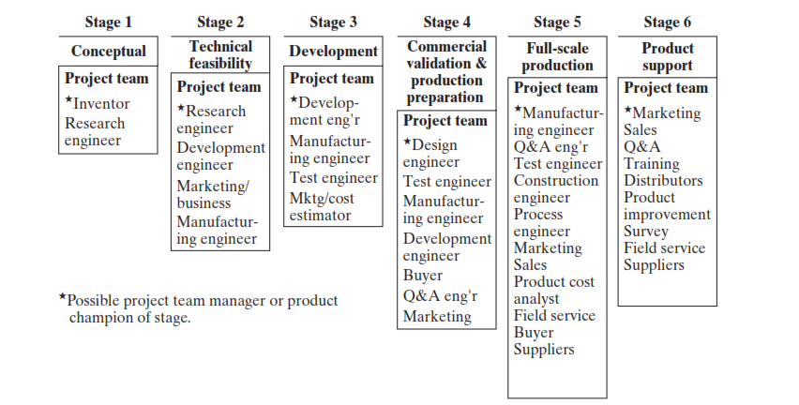
Concurrent (simultaneous) engineering

